Slide 1


SWAM: Revisiting Swap and OOMK for Improving Application Responsiveness on Mobile Devices
MobiCom 2023
(The 29th Annual International Conference On Mobile Computing And Networking)
Session 21: Smartphone Apps & Platforms
Oct-05-2023
Geunsik Lim, Donghyun Kang, MyungJoo Ham, and Young Ik Eom

Slide 2
Outline
Motivation
Background
SWAM: Design & Implementation
Evaluation
Demo
Conclusion

Slide 3

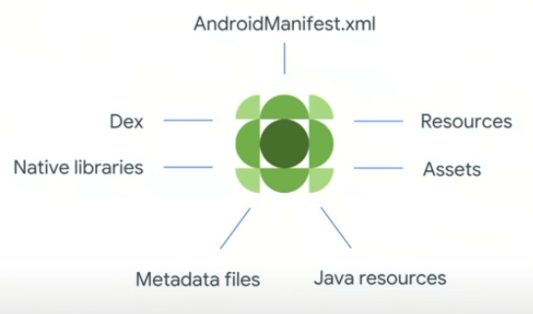
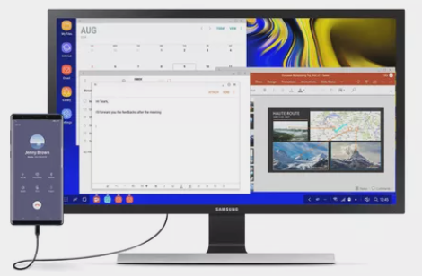
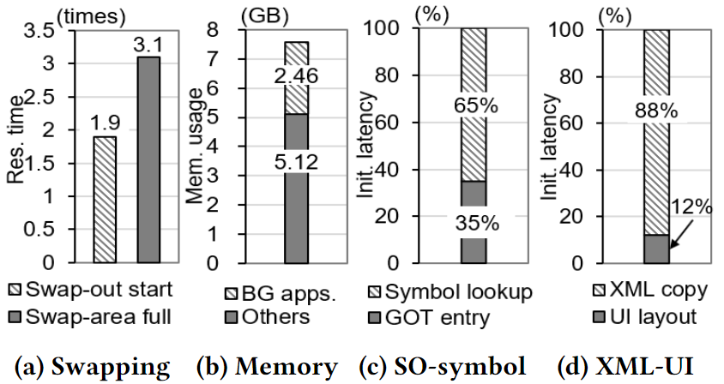
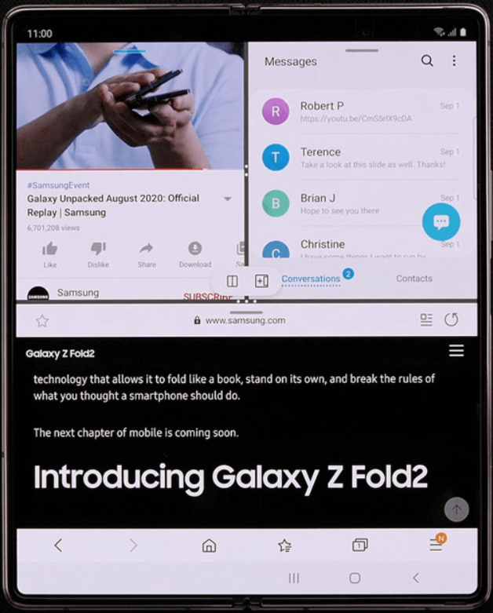


Motivation
512MB (2010) → 8GB (2022)
RAM capacity increase on smartphone
Increase app capacity (developers)
More concurrent apps (app scenarios)
Samsung Dex
Video
SNS
Web-browsing
Slower app launch and responsiveness
Big Data Platform

Slide 4






Background
Traditional OS supports two MMs to obtain free memory
* MM: Memory Management
Do not kill processes
Oops. It’s weird.
A mobile app is too slow.
1) Res. Time (Swapping )
2) Mem. Usage (B/G Services)
Swap to preserve apps status
Do kill processes
Oops. My stock app is forcibly killed without my intention.
3) Init. Latency (SO-Lookup + XML-Processing)
OOMK to launch new apps quickly
The merits of two MMs
The demerits of two MMs
Our observation: 3 Kinds of PERF Impacts w/ 4 sources

Slide 5

SWAM: System Overview
SWAM efficiently orchestrates the traditional swapping and killing schemes
3 PERF Impacts | Components | Color | Goal (Strong points against existing systems)
Mem. Usage | (1) Adaptive Swap | Blue | Dynamically adjusts swap space and provides two independent paths (e.g., fast path and slow path) for swapping
Mem. Usage+ Res. Time | (2) OOM Cleaner | Green | Clears shared object (SO) pages without destroying apps
Init. latency | (3) EOOM Killer | Red | Kills apps that can be swiftly relaunched based on SO/XML
RAM
(fast path)
(3) EOOM Killer
System
RAM
ZRAM
(slow path)
zram-out
(2) OOM Cleaner
(1) Adaptive Swap
swap-clean
NAND flash
/opt/user/apk/***
/opt/user/img/***
(EXT4)
SWAM files
swap-out
System overview of SWAM

Slide 6
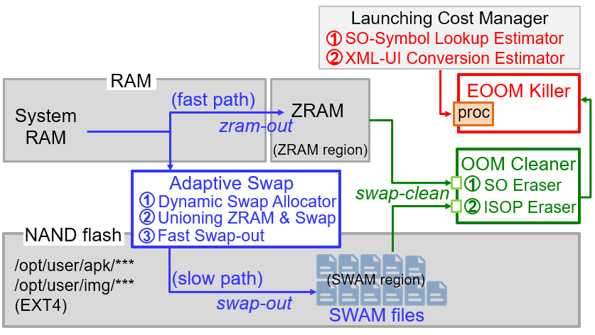
SWAM: Adaptive Swap 1/3
Adjusts swap size dynamically
Swap-out SO pages w/ access history
“swam” files
Uses characteristics of SO to choose victims
Swap-out heap/stack/shared-mem after SO pages are out
Note: Numerous symbols contained within SO files are never accessed by another App

Slide 7
SWAM: Adaptive Swap 2/3
RAM or NAND decision for Victim
Normal page of “prioritized” app → ZRAM
SO: not shared → NAND Flash

Slide 8
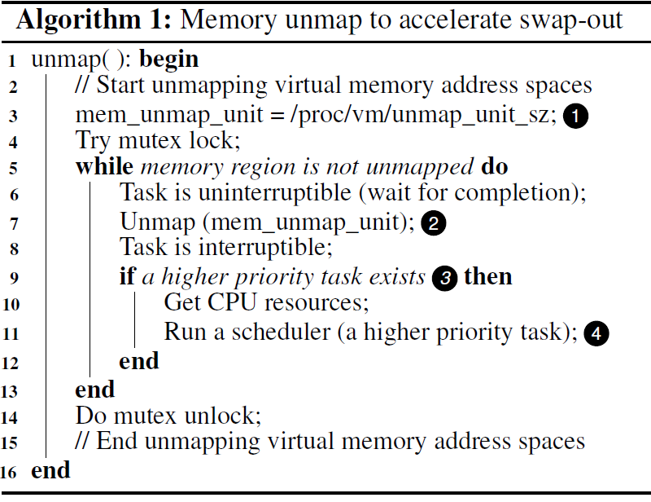
SWAM: Adaptive Swap 3/3
Temporarily dynamically change the memory “unmap” condition during a swap-out request.
→ Purpose: to speed-up large "unmap" operations

Slide 9
SWAM: OOM Cleaner
Out of memory even with Adaptive Swap
Run OOM Cleaner
(1) SO Eraser:
Deleting “least shared” SO pages in ZRAM (If used, additional burdens such as link/load, symbol lookup, etc.)
(2) ISOP Eraser:
LRU-based removal of SO page in SWAM region (Long-term, remove unused pages first)
SO: Shared Object
ISOP: Idle Swapped-Out Page

Slide 10
SWAM: EOOM Killer
Same function as OOMK
However, using the information of Android App-F/W, Victim with less user impact was found
→ (1) So-Symbol lookup burden prediction
→ (2) XML-UI burden estimation

Slide 11


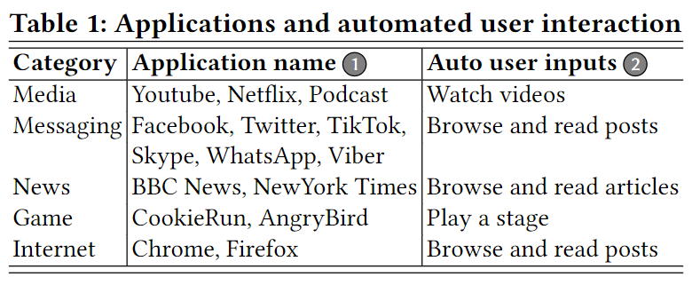
Evaluation Environment
Google Pixel 6 (AOSP 12, 128GB eUFS 3.1)
“High-end” (Flagship): use as it is (8-cores, 8GB RAM)
ZRAM: 1GB / NAND-Swap: 3GB
“Low-end” (Emulated): limit to (4-cores, 4GB RAM)
ZRAM: 512MB / NAND-Swap: 2GB
15 foreground apps evaluated
Automated tst for 1.5 hours
25 background apps
Reboot & leave 30 days (1month)
*1)
*1) Source: SIMFORM, App Usage Statistics 2021 that will Surprise You, 2022

Slide 12
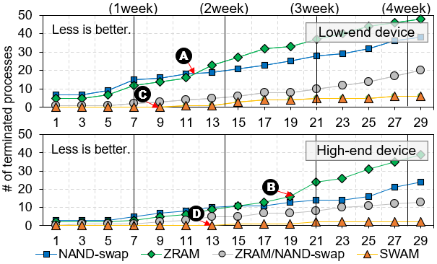
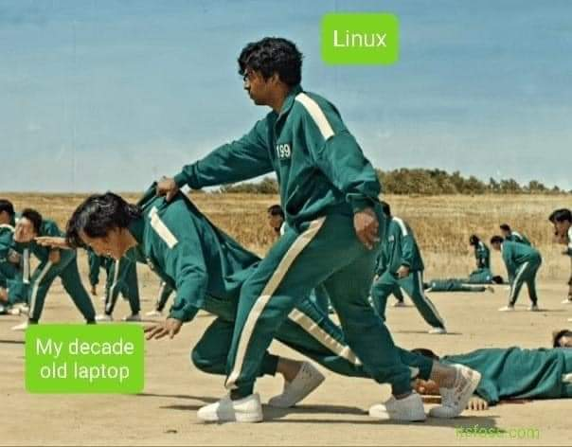

Evaluation: # of killed apps
SWAM
# of killed Apps
, : Collapse point of ZRAM benefit
A
B
, : No OOMK operations of SWAM
C
D
The number of accumulated OOMKs on low-end (above) and high-end (below) mobile devices

Slide 13
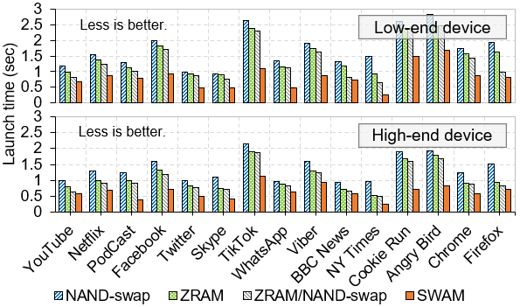
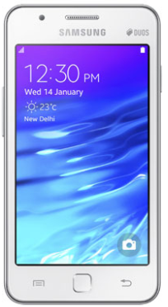
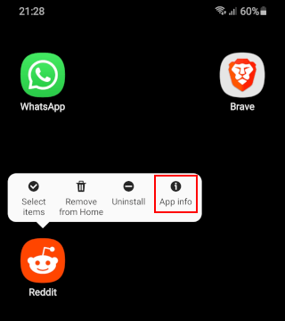
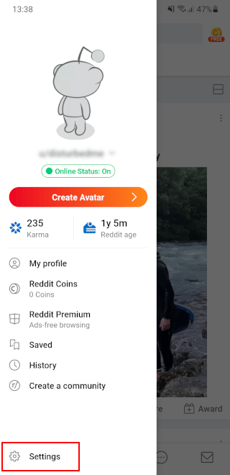

Evaluation: Launch time of apps
App launch time
up to 38%
Time from clicking an app icon to seeing the first screen
up to 36%
00:00.00 00:03.70

Slide 14
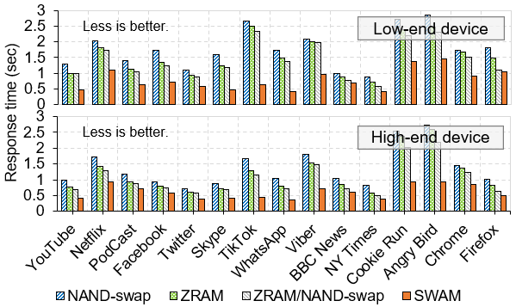
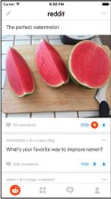


Evaluation: Response time of apps
App response time
up to 44%
Waiting time for the user to see an app menu's execution outcome
up to 41%
00:00.00 00:01.72 00:02.36

Slide 15
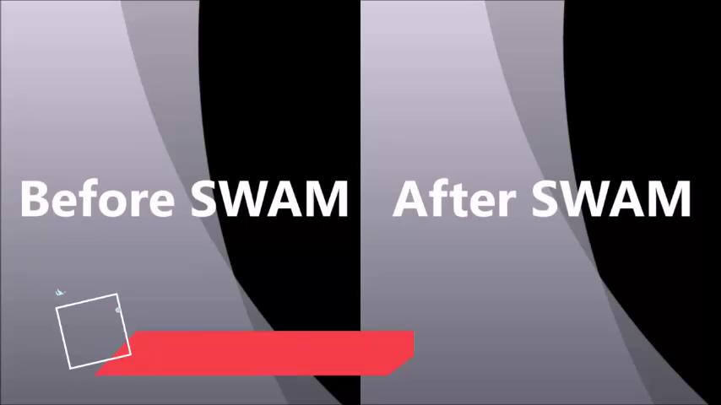
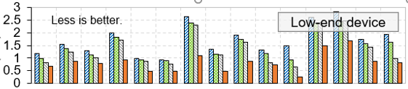
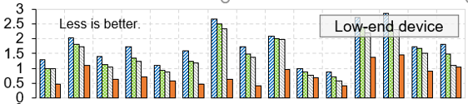
Demo
App launch time and response time which are measured for user interactions with each app
Launch time (sec)
up to 38%
Launch time of apps
Res. time (sec)
up to 44%
Video
* The mobile env., RAM size, and working conditions used in this demo are all the same.
Response time of apps

Slide 16

Conclusion
We highlight the structural limitations of the traditional swapping and killing mechanisms which operate independently
We propose a state-of-the-art memory management technique (SWAM) that complements the traditional schemes to improve application responsiveness
1) Adaptive Swap: dynamically adjusts swap space and provides two independent paths
(e.g., fast/slow path) for swapping
2) OOM Cleaner: clears SO pages without destroying applications
3) EOOM Killer: kills applications that can be swiftly relaunched based on
Launching Cost Manager hints
SWAM

Slide 17
Thank you!

